Slide 1
AWS Lambda Function
Thang Tran – Cloud Developer
OWORX – Powered by SCC

Slide 2
Agenda
AWS Serverless
AWS Lambda Function
How AWS Lambda works?
Lambda Function Common Use cases
AWS CloudFormation
Demo

Slide 3
AWS Serverless
Native architecture of AWS
Build and run applications without thinking about servers
Eliminates infrastructure management tasks:
Server or cluster provisioning
Patching
Operating system maintenance
Capacity provisioning
Focus on core product
The AWS serverless platform: Compute, Storage, Data stores, Analytics .etc.

Slide 4
Lambda Function
Has the AWS Serverless advantages
Executes your code only when needed and scales automatically
Pay only for the compute time you consume (every 100ms your code executes)
AWS Lambda supports many languages at runtime: Node.js, Python, Ruby, Java, Go, .NET Core
Support async/await in Node.js and .NET Core

Slide 5
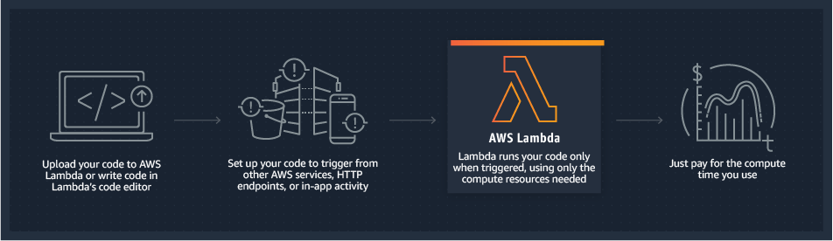
How AWS Lambda works?

Slide 6
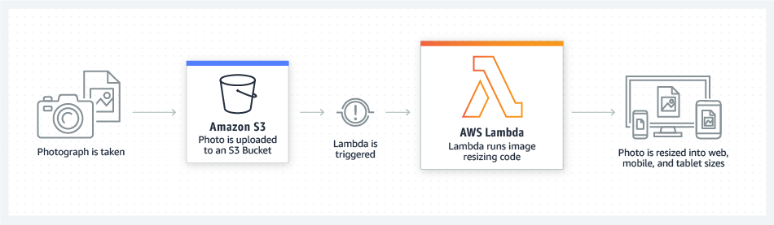
Lambda Function Common Use cases Events processing

Slide 7
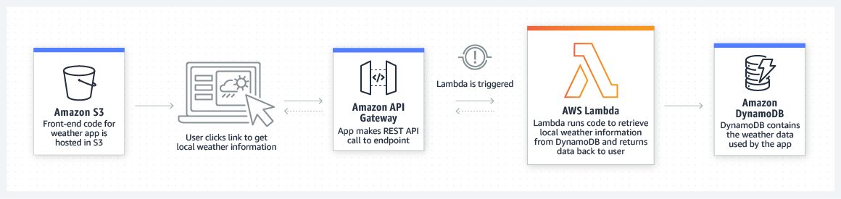
Lambda Function Common Use cases Back-end REST API

Slide 8
AWS CloudFormation Introduction
Model our entire infrastructure and application resources in a template
Automate & deploy build and rebuild your infrastructure and applications
It's just code

Slide 9
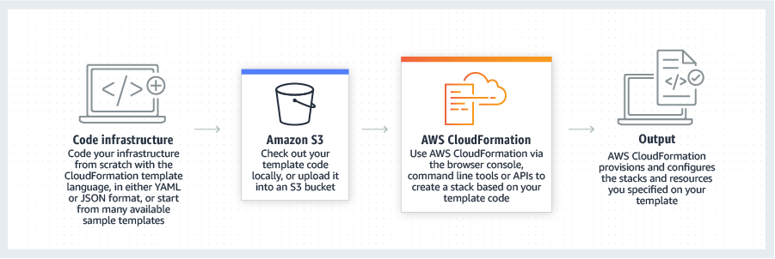
How CloudFormation works?

Slide 10
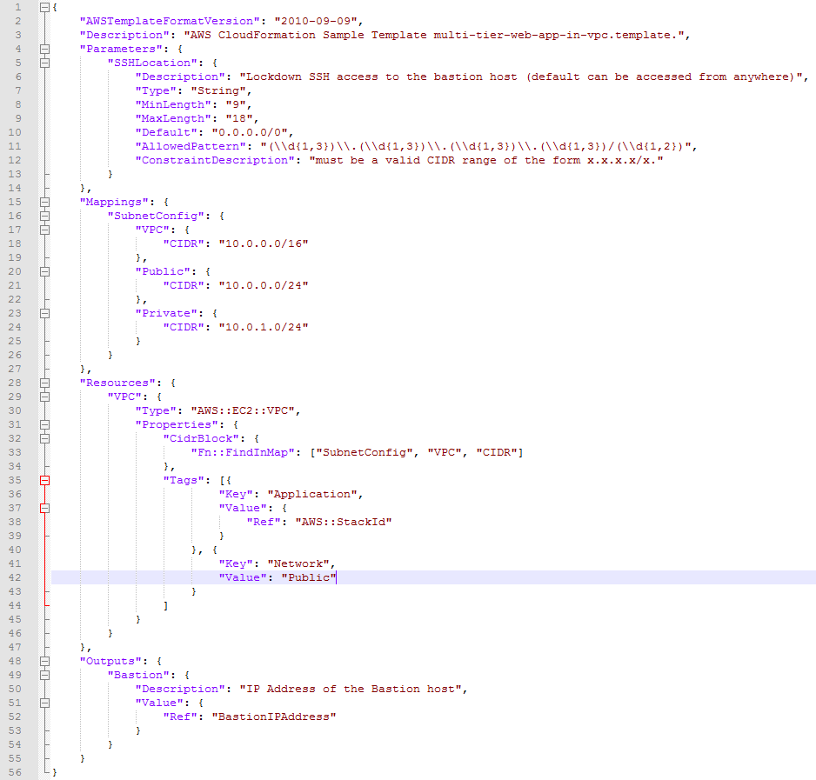
CloudFormation Template

Slide 11
Development Tools
Visual Studio 2019 and AWS Toolkit for Visual Studio
Visual Studio Code and AWS Toolkit for Visual Studio Code
AWS Command Line Interface (CLI)
AWS Lambda for .NET Core

Slide 12
Demo
Lambda Function as an back-end API
Lambda Function as AWS S3 events Handler
Register to AWS my Lambda Function

Slide 13
Register AWS Lambda Function using CLI
dotnet lambda deploy-serverless -cfg aws-lambda-tools-defaults.json -pcfg true
dotnet lambda deploy-serverless -cfg aws-lambda-tools-defaults.json -tp BucketName="" -pcfg true

Slide 14
Define Lambda Function by using AWS console
Compare the S3 zip file and the publish folder

Slide 15
Q&A

Slide 16
References
Blog Developing .NET Core AWS Lambda functions (https://aws.amazon.com/blogs/compute/developing-net-core-aws-lambda-functions/)
AWS Toolkit for Visual Studio (https://aws.amazon.com/visualstudio/)
AWS Toolkit for Visual Studio Code (https://aws.amazon.com/visualstudiocode/)
AWS CLI (https://docs.aws.amazon.com/cli/latest/userguide/cli-chap-install.html)
AWS Lambda for .NET Core (https://github.com/aws/aws-lambda-dotnet)

Slide 17
Demo source code
https://github.com/thangtran76/lambda-function

